Slide 1

Geographical Statistics of Engineering Internships
CYLIA BERKANE
FAGNUO CAI
GUSTAVO FLEURY
INDURAJ PR
QUOC VIET PHAM
YEN CHU CHEN
April / 2019
Notes:
As próximas visitas serão compostas por 2 consultores;

Slide 2
AGENDA
1
3
Future Evolution/Conclusion
2
The Project
Technical Solutions
Management Solutions
4
5
Machine Learn Solutions

Slide 3
The Project – User Requirements
Resume of Introduction Document: Requirements, premises, etc.

Slide 4

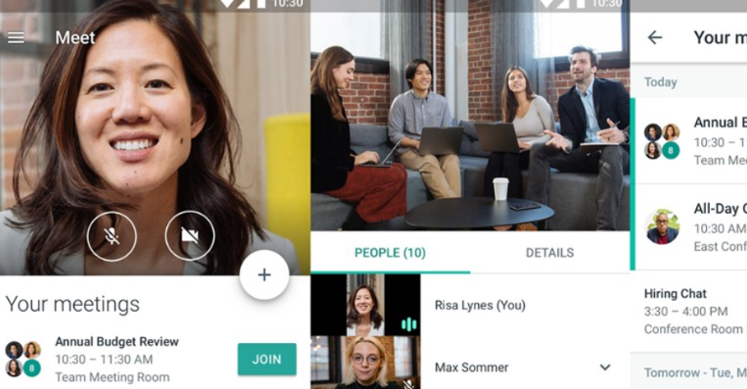
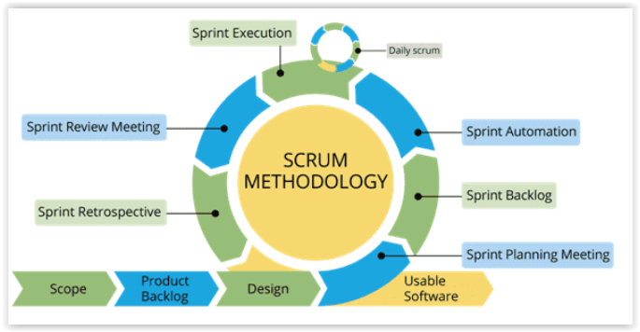
Management Solution - SCRUM
Notes:
-

Slide 5
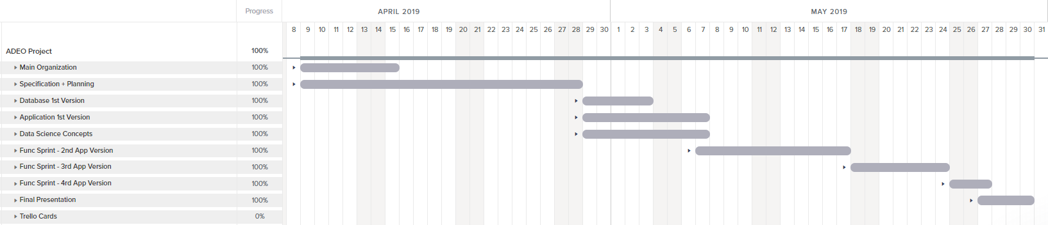
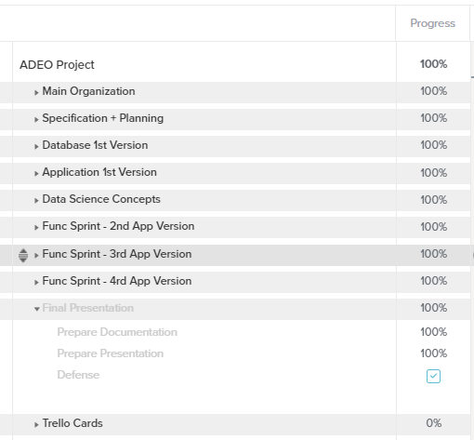
Management Solution - TeamGantt

Slide 6
Team Tasks Division
Infrastructure
Data Analysis / Statistics
Visualization / Documentation
Viet
Gustavo
Cai
Indu
Janet
Cylia
MANAGEMENT
Gustavo / Indu / Viet

Slide 7





Management Solutions
Backlog
Sync Problems

Slide 8


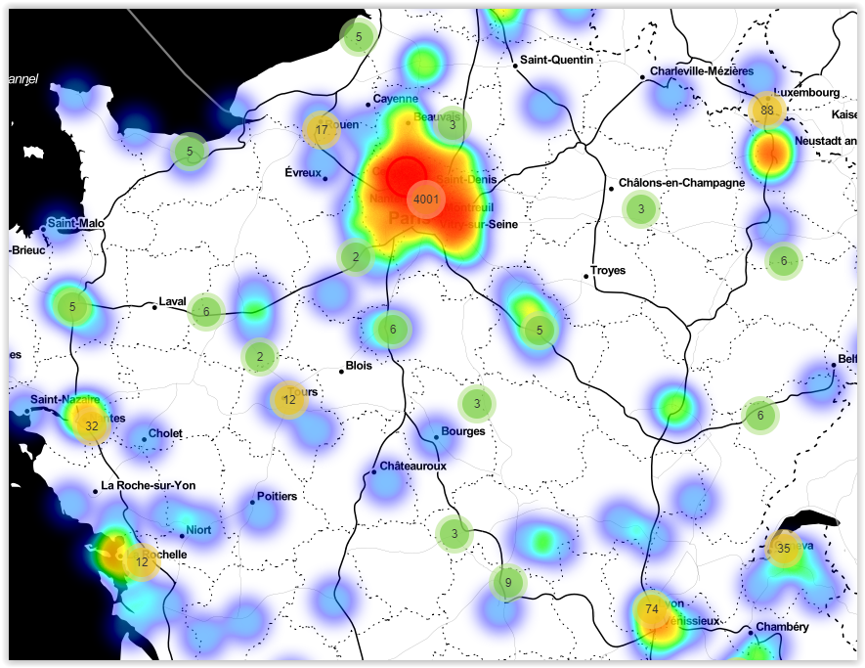





Technical Solutions
Bootstrap
Framework
Folium
Python
Chart.js
Database
ETL
Anaconda

Slide 9
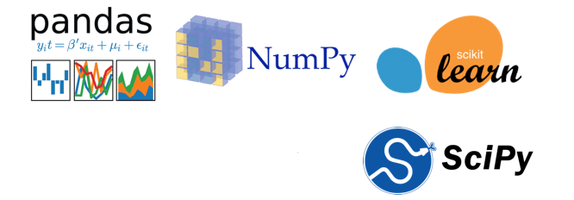
Python, Machine learning with Python
Python, Machine learing with Python:
Pandas: providing fast, flexible, and expressive data structures designed to make working with structured (tabular, multidimensional...) and time series data easy and intuitive.
Numpy: support for large, multi-dimensional arrays and matrices, along with a large collection of high-level mathematical functions to operate on these arrays.
Scikit-Learn: Scikit-learn provides a wide selection of supervised and unsupervised machine learning algorithms.

Slide 10
SQLite-Relational Database management system
SQLite (relational database management system): The lite in SQLite means light weight in terms of setup, database administration, and required resource.
SQLite has the following noticeable features: self-contained, serverless, zero-configuration, transactional.
Database
ETL

Slide 11
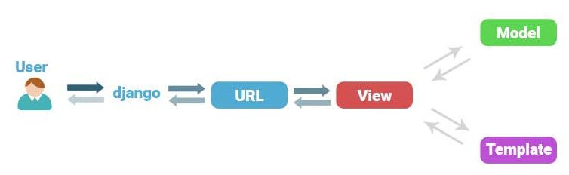
DJANGO MVC - MVT Pattern
Framework
Python
Anaconda
The Model-View-Template (MVT) is slightly different from MVC.
Django itself takes care of the Controller part (Software Code that controls the interactions between the Model and View), leaving us with the template.
The template is a HTML file mixed with Django Template Language (DTL).

Slide 12
User Interface
Bootstrap
Chart.js
Folium
Bootstrap is an open source toolkit for developing with HTML, CSS, and Java Script.
Responsive: with the increase in Smartphone usage, the demand for responsive websites has increased tremendously. A responsive layout and 12-column grid system are present in Bootstrap that aid in website adjustment according to screen size.
Chart.js: is a powerful data visualization library.
Folium: is another data visualization library in Python that was built primarily to help visualize geospatial data.

Slide 13

Machine Learn Solutions - ETL
PRG_STUDENT
_SITE
ADR_STUDENTS
STUDENT
_INTERNSHIP
Database
Merged Table

Slide 14

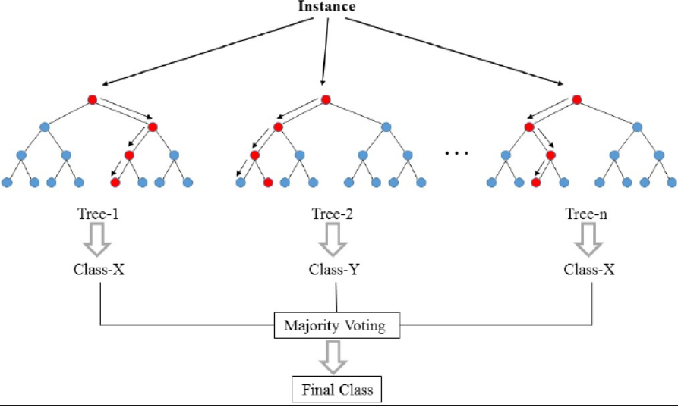
Random Forest
Remuneration
Source: https://fr.wikipedia.org/wiki/For%C3%AAt_d%27arbres_d%C3%A9cisionnels

Slide 15

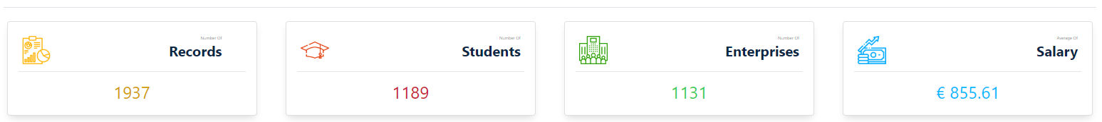

Random Forest - Comparative
+ 15% Data

Slide 16
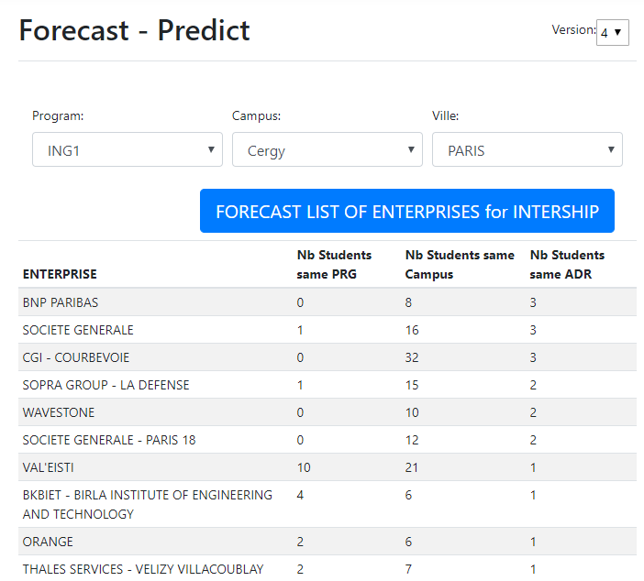
Intership Predict

Slide 17
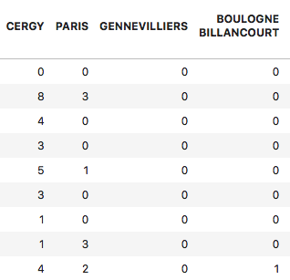
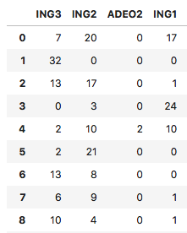
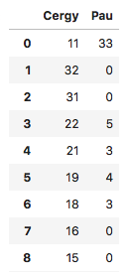
Internship Prediction - Algorithm
Program-Enterprise
Campus-Enterprise
Addresse-Enterprise

Slide 18




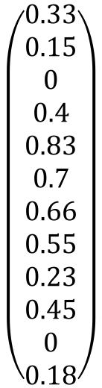
Internship Prediction - Algorithm
Decision?
$$\left(\begin{aligned}0.33 \\ 0.15 \\ 0 \\ 0.4 \\ 0.83 \\ 0.7 \\ 0.66 \\ 0.55 \\ 0.23 \\ 0.45 \\ 0 \\ 0.18\end{aligned}\right)$$
?
?
?
W0 ×
+ W1 ×
+ W2 ×
=

Slide 19
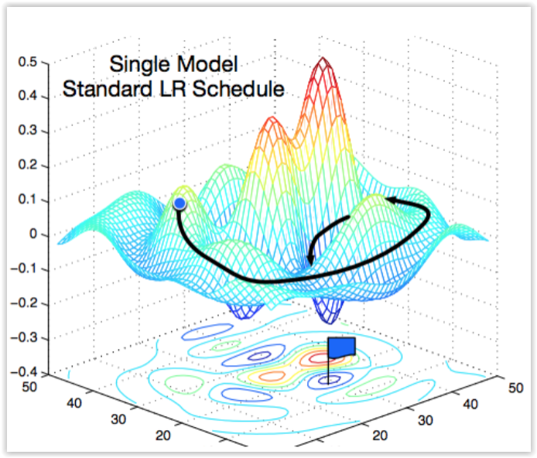
Gradient Descent
Source: https://medium.com/38th-street-studios/exploring-stochastic-gradient-descent-with-restarts-sgdr-fa206c38a74e

Slide 20

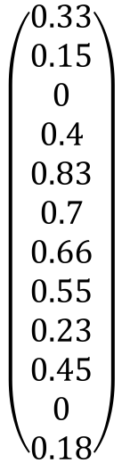

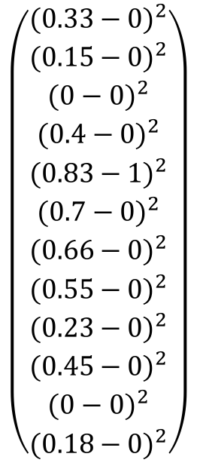
Gradient Descent – Cost Function
Output
Desired output
$$\left(\begin{aligned}{(0.33−0)}^{2} \\ {(0.15−0)}^{2} \\ {(0−0)}^{2} \\ {(0.4−0)}^{2} \\ {(0.83−1)}^{2} \\ {(0.7−0)}^{2} \\ {(0.66−0)}^{2} \\ {(0.55−0)}^{2} \\ {(0.23−0)}^{2} \\ {(0.45−0)}^{2} \\ {(0−0)}^{2} \\ {(0.18−0)}^{2}\end{aligned}\right)$$
$$\left(\begin{aligned}0.33 \\ 0.15 \\ 0 \\ 0.4 \\ 0.83 \\ 0.7 \\ 0.66 \\ 0.55 \\ 0.23 \\ 0.45 \\ 0 \\ 0.18\end{aligned}\right)$$
$$\left(\begin{aligned}0 \\ 0 \\ 0 \\ 0 \\ 1 \\ 0 \\ 0 \\ 0 \\ 0 \\ 0 \\ 0 \\ 0\end{aligned}\right)$$
$$C0=$$

Slide 21
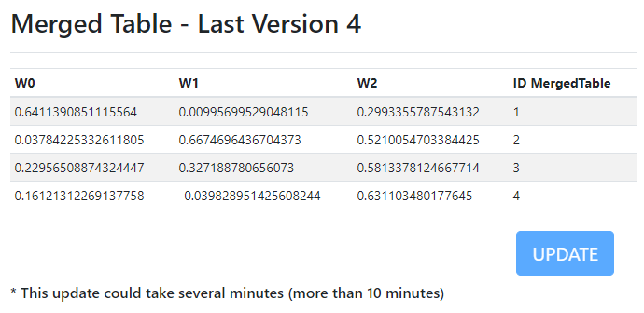
Intership Predict - Algorithm

Slide 22
Intership Predict – Performance Problem
Weight Calculations
Tables Transformations
Acceptable Response Time
> 10 minutes
> 55 seconds
<10 seconds
< 0.2 seconds
Register Values/Table in Database
Team Work

Slide 23

Address
VILLE, CODE_POSTAL, PAYS
Performance
GMaps API
MergedTable
Register LAT / LON in Database

Slide 24
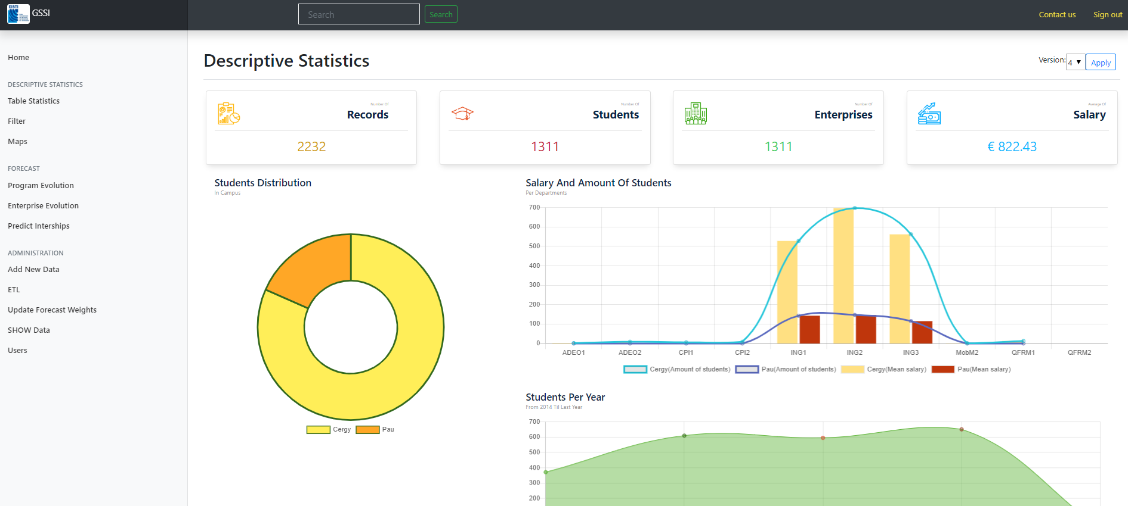
The System – Live Presentation

Slide 25

Future Evolutions
More friendly user interface
with helps and Popups
Suggestion and Guiding error message
Uniform graph interfaces
Aditional graphs
Functionalities such as
Export reports (Ex: PDF) /Printing Options
More admin options, such as user priviledges
Problems with enterprise forecasting (name error’s)

Slide 26
Conclusions
This system developed as a prototype needs little more refinements,
With the refinements, making the system go online, it would be of much use for the actors of the system

Slide 27
Thank you!
Questions?

